Slide 1
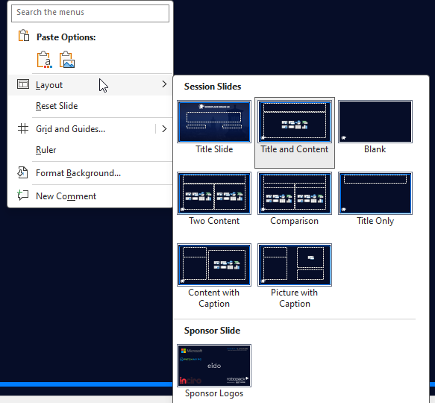
Workplace Ninjas DK – Presentation Guide
Layouts are available when you create a new slide.
The sponsor slide must remain included and unchanged.
Please do not overlap images through the border – for large images, use the Blank layout
Workplace Ninjas DK assumes you have sought appropriate permission to use the content in your presentation.
It is your responsibility to ensure you are not breaking NDAs or infringing on copyright notices.
Delete this slide when ready to present.
February 2025 Version – Final sponsor slide will be distributed when finalised.

Slide 2

Workplace Ninjas DK
February 2026
Edition

Slide 4


